Slide 1
Capstone Management

Slide 2
Problem listing

Slide 3
Project Goal

Slide 4
Project requirement

Slide 5
Project feasibility - Sean

Slide 6
Project Plan - Sean
Sprint/Release plan

Slide 7
Project management - Sean
Github
Trello
Group work autonomously

Slide 8
Project Design
Why python and Django
Database Design
Low/Med/High Fidelity

Slide 9
Why python and Django
PYTHON AND DJANGO ARE HUGE IN FINTECH
IT HAS A TON OF RESOURCES
DJANGO, A HIGH-LEVEL PYTHON WEB FRAMEWORK, IS FLAT-OUT AMAZING

Slide 10
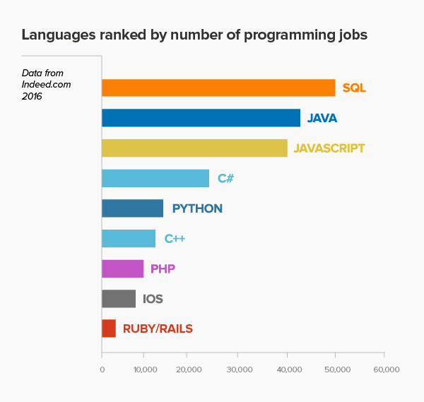
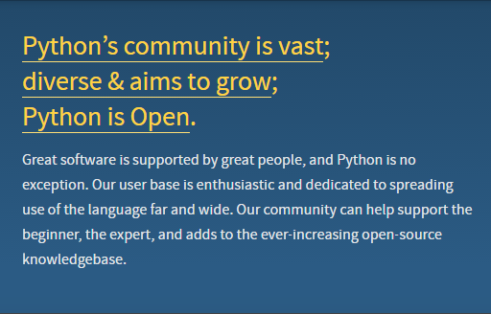
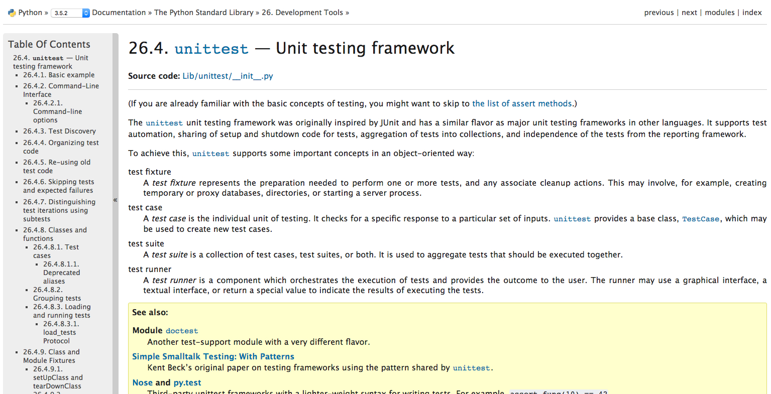
Huge COMMUNITY AND A TON OF RESOURCE

Slide 11
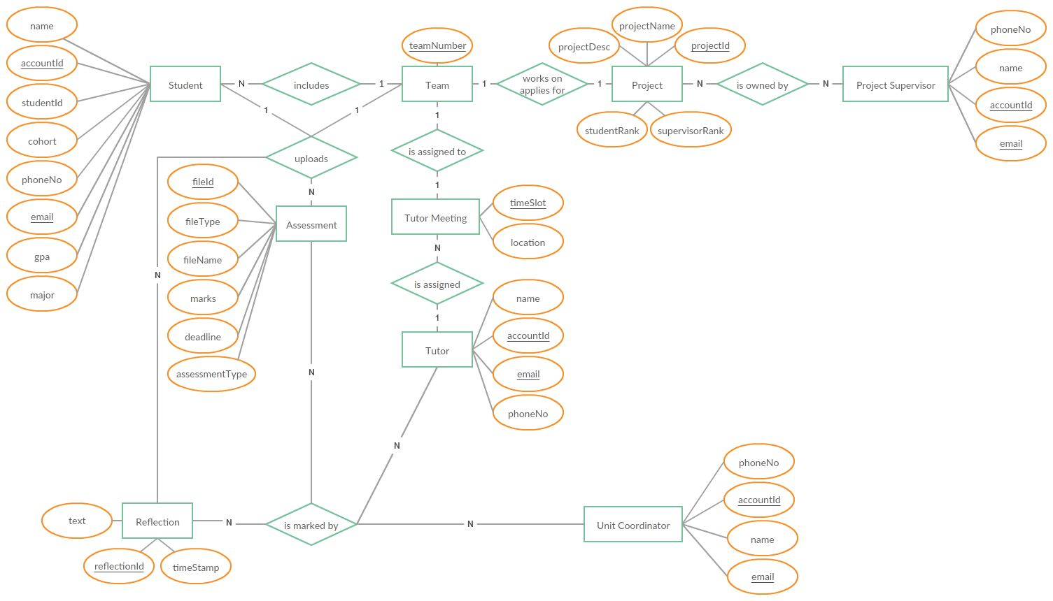
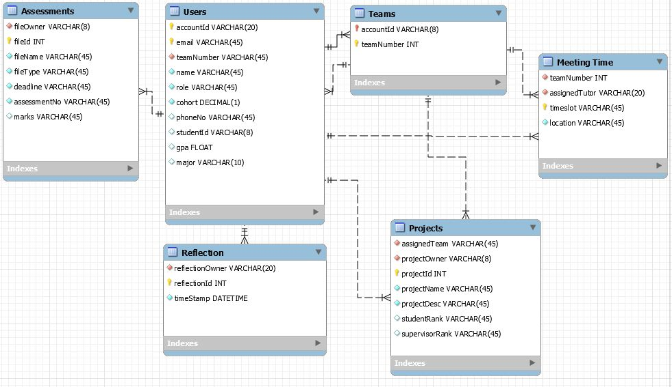
How to make Database Design
Entity Relationship Diagram
Database Tables

Slide 12
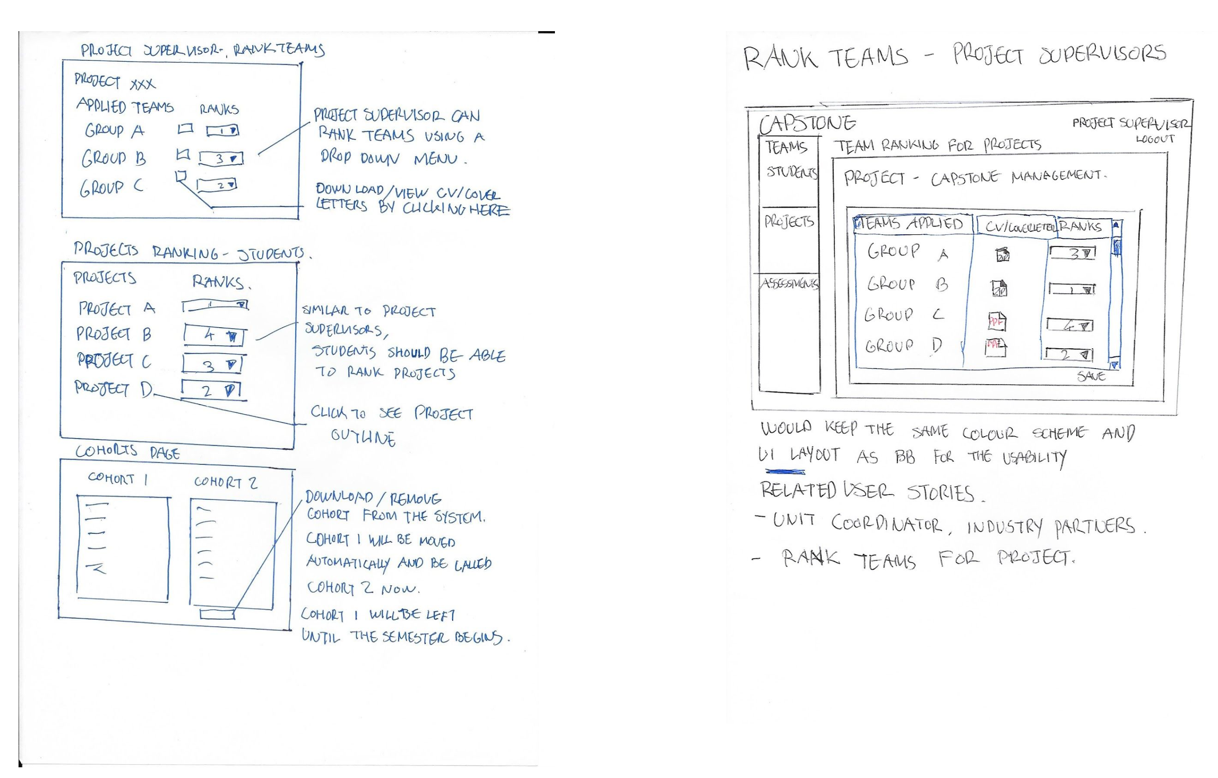
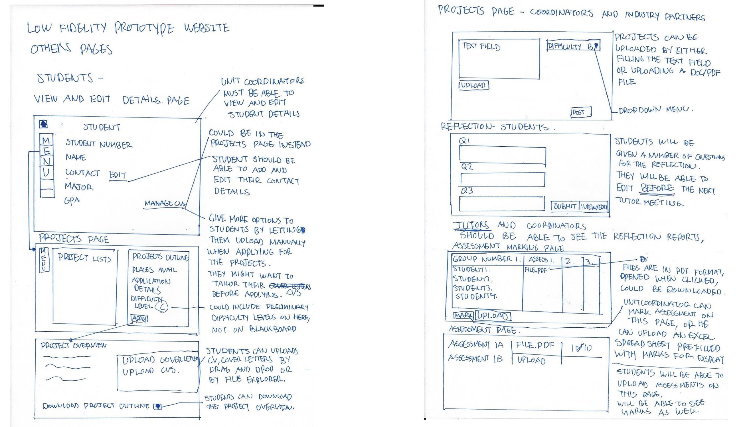
Low Fidelity

Slide 13
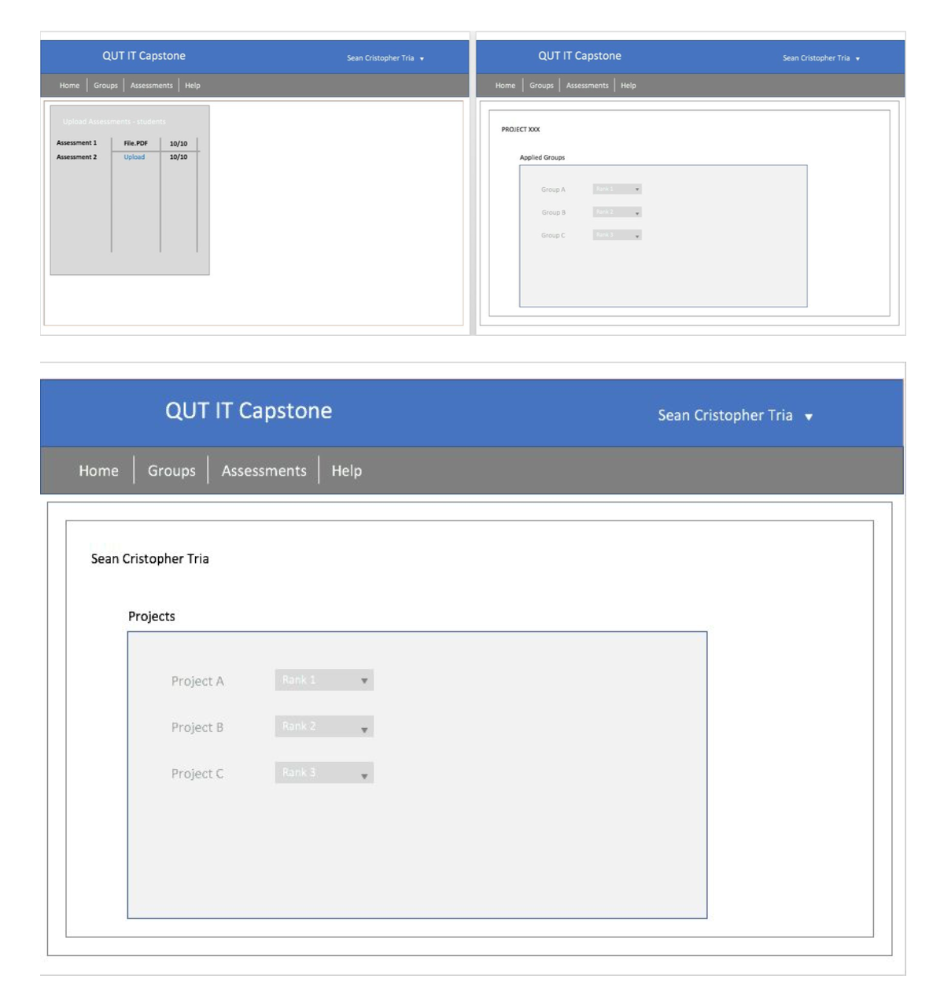
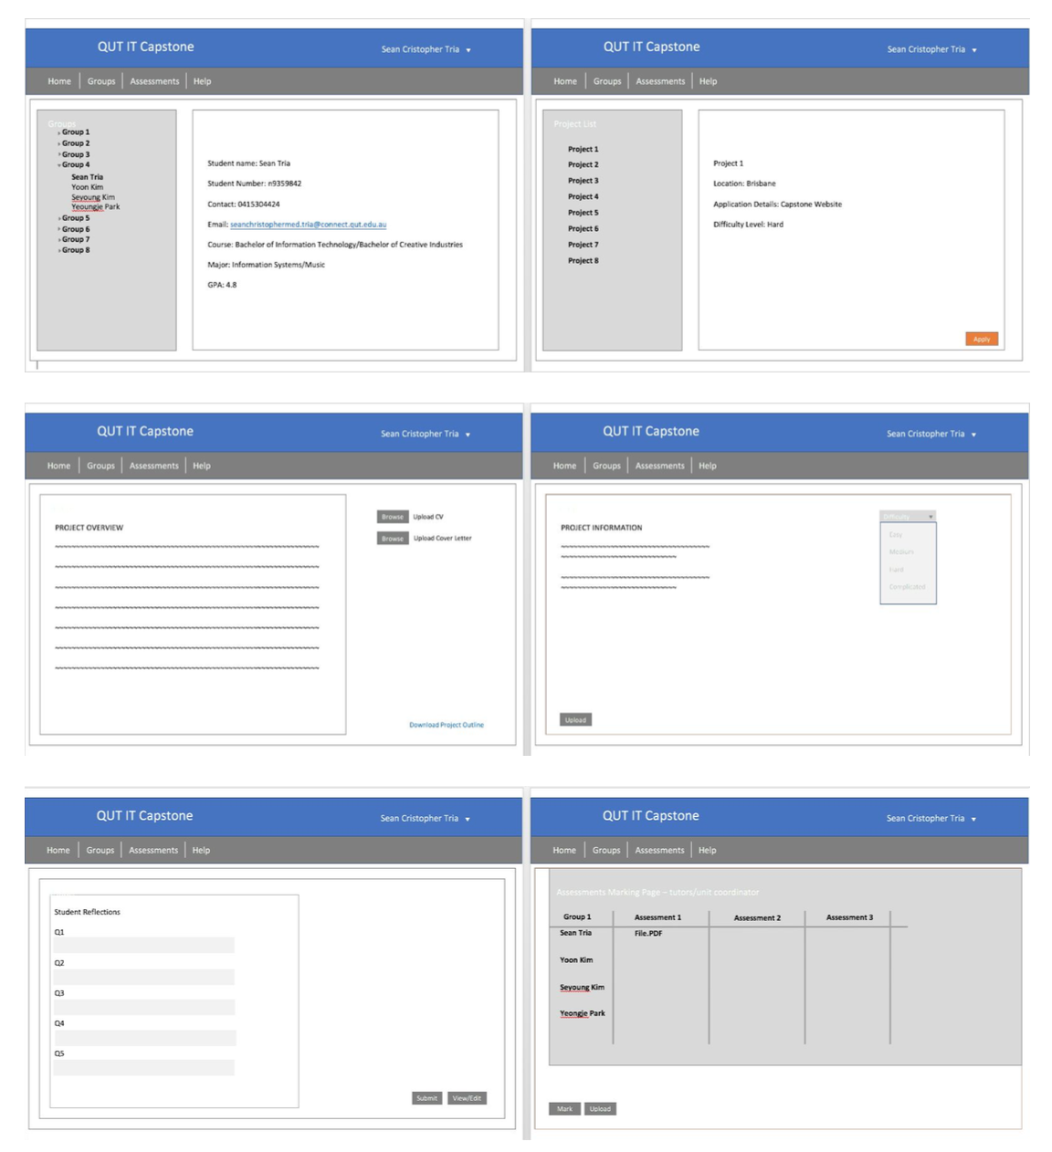
Med Fidelity

Slide 14
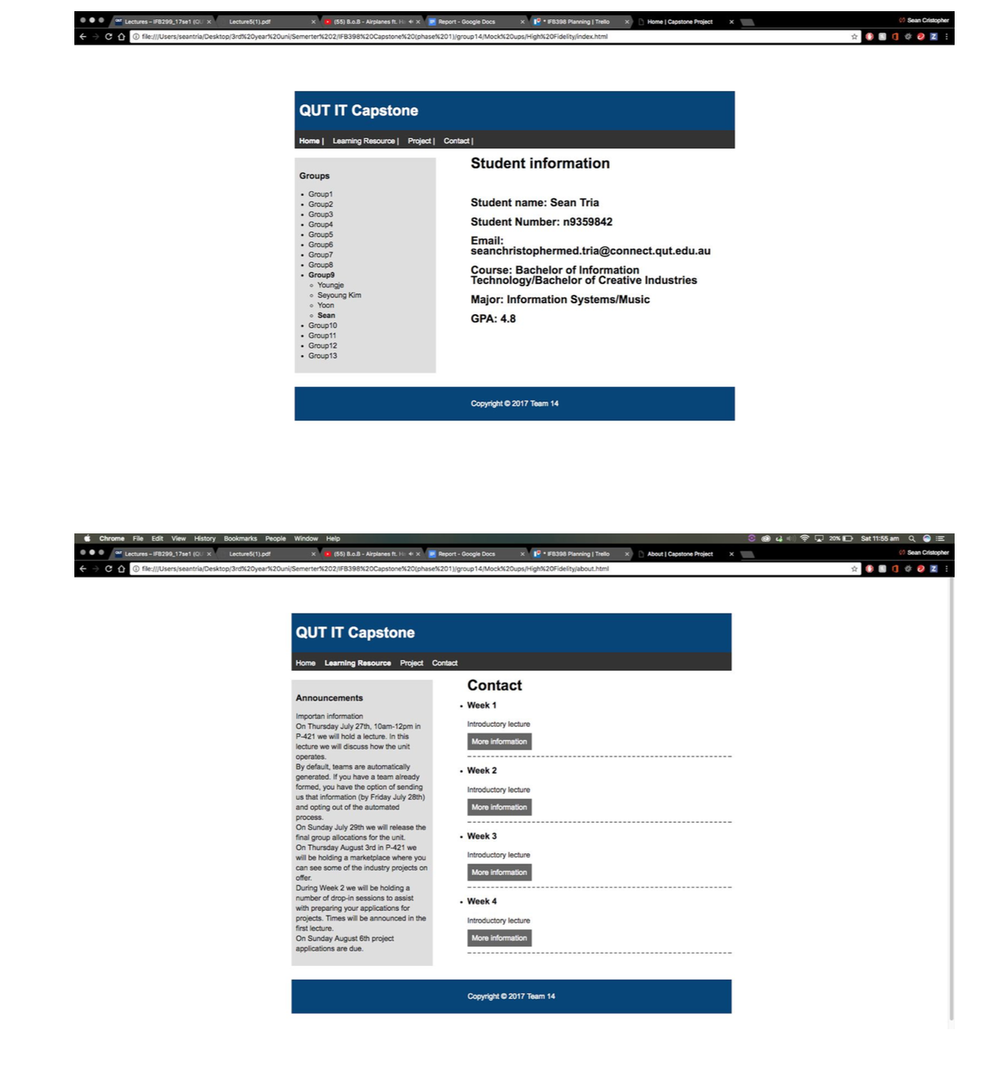
High Fidelity

Slide 15
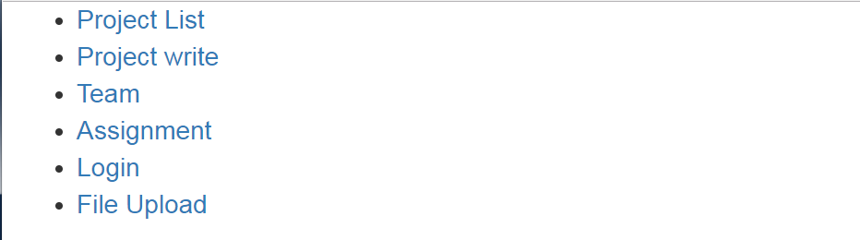
Initial Work and Prototype for web application (Functional prototype pages)
First Page

Slide 16
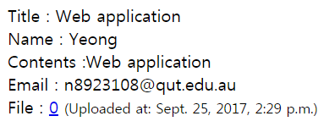
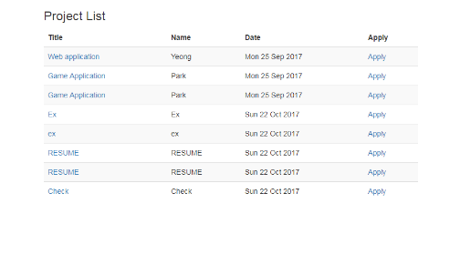
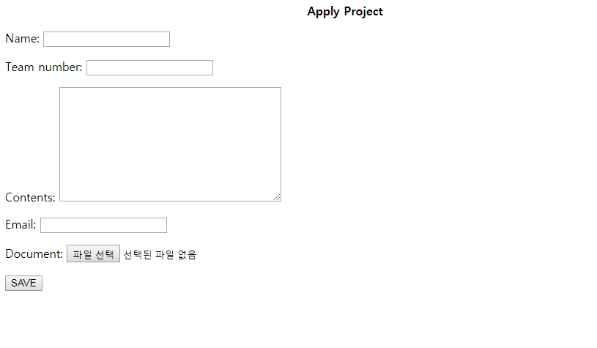
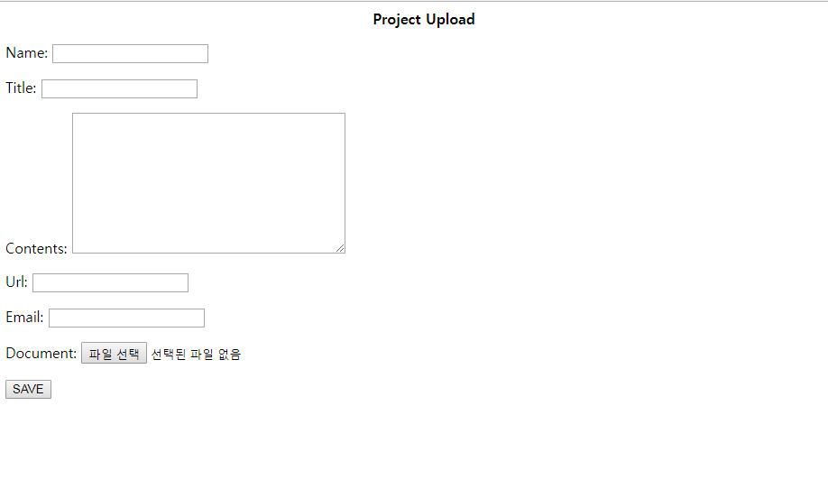
Project Detail
Project List
Project Pages
Project Upload
Apply Project

Slide 17
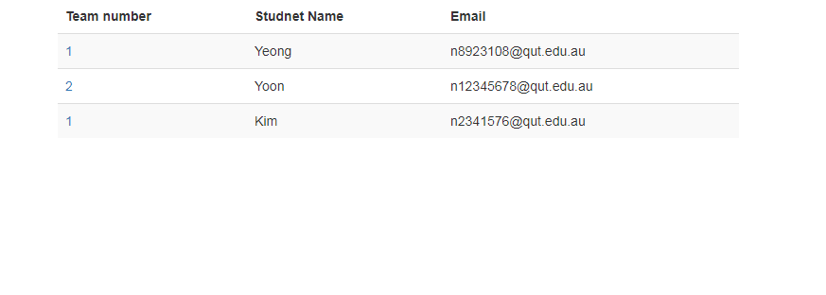
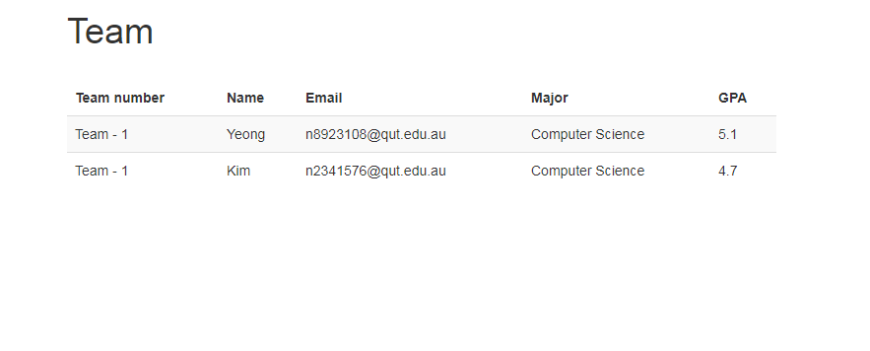
Student Information
Team Member Information
Student & Team Detail

Slide 18
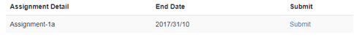
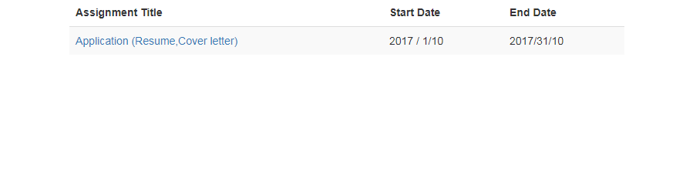
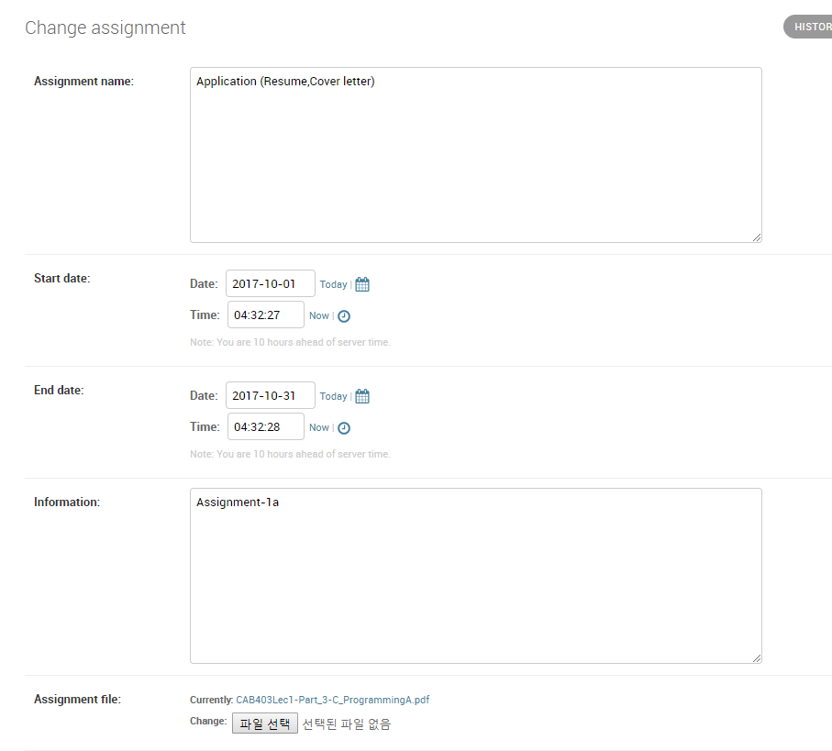
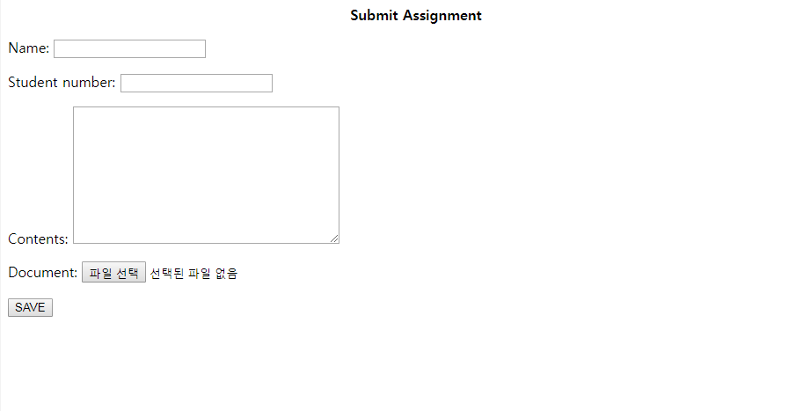
Assignment pages
Assignment Detail
Assignment Detail
Upload Assignment
Submit Assignment

Slide 19
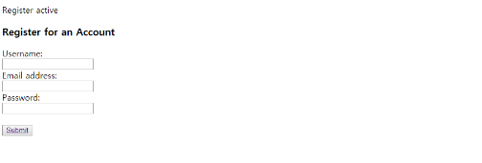
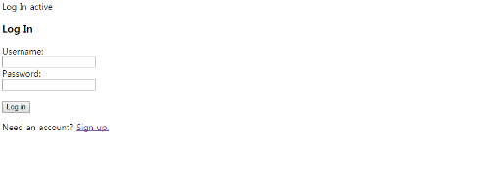
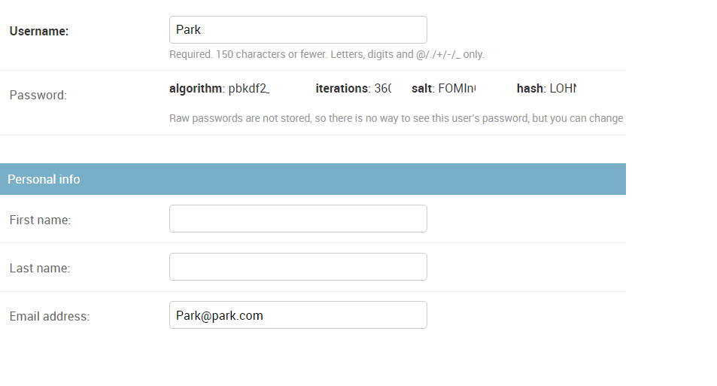
Log-in & Sign-up pages
Sign-Up
User Detail
Log-in

